Slide 1
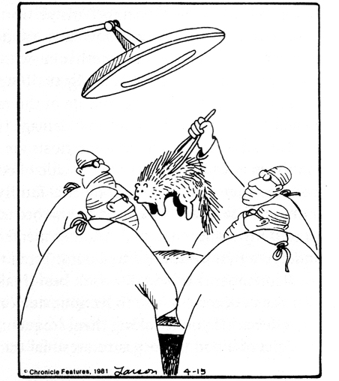

Pain
LO
“Well, I guess that explains the abdominal pains.”
“Pain is a component of virtually all clinical
strategies, and management of pain is a primary
clinical imperative. Opioids are a mainstay of pain
treatment.”
Goodman & Gilman, 12th edition

Slide 2
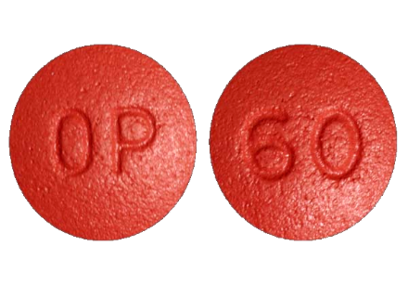
Opioid Analgesics
Addiction

Slide 3
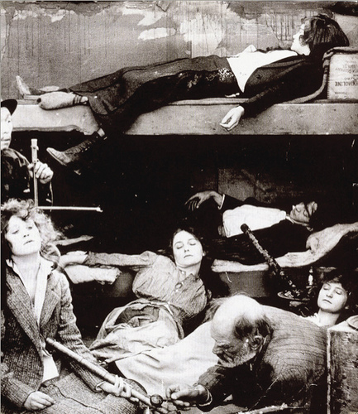
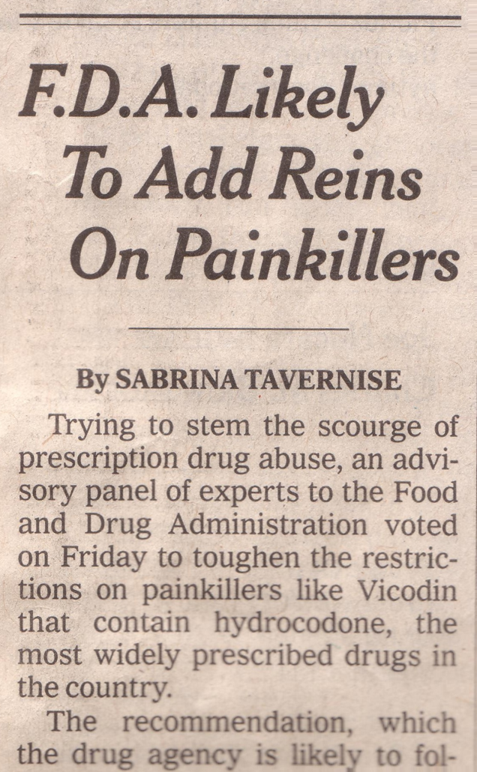
Opioid Analgesics
Addiction
The Dividend, 1916
January 26, 2013 New York Times

Slide 4
Opioid Analgesics
Addiction
New York Times, March 2016

Slide 5
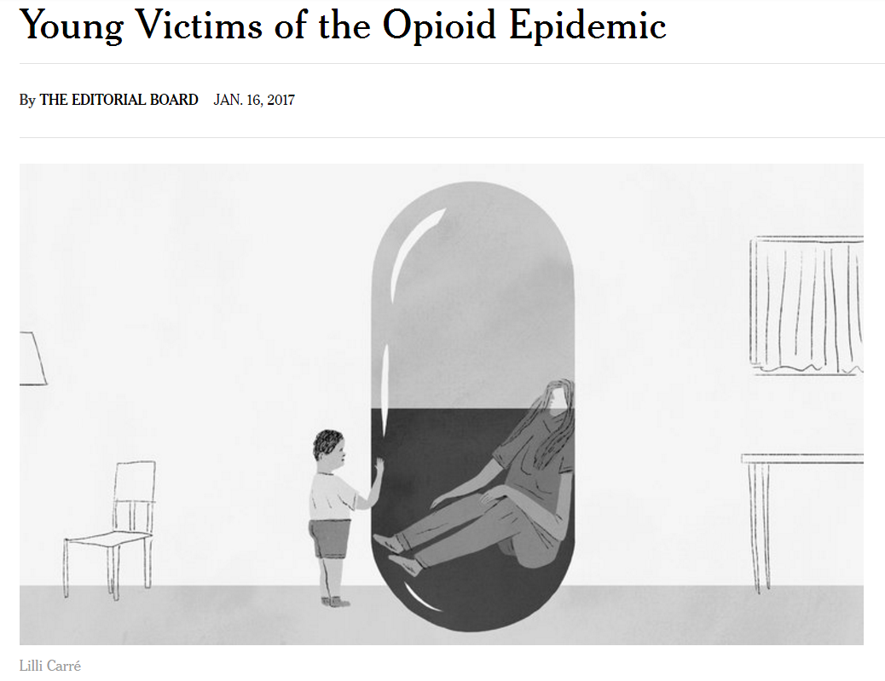
Opioid Analgesics
Addiction
New York Times, January 2017

Slide 6
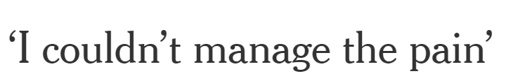
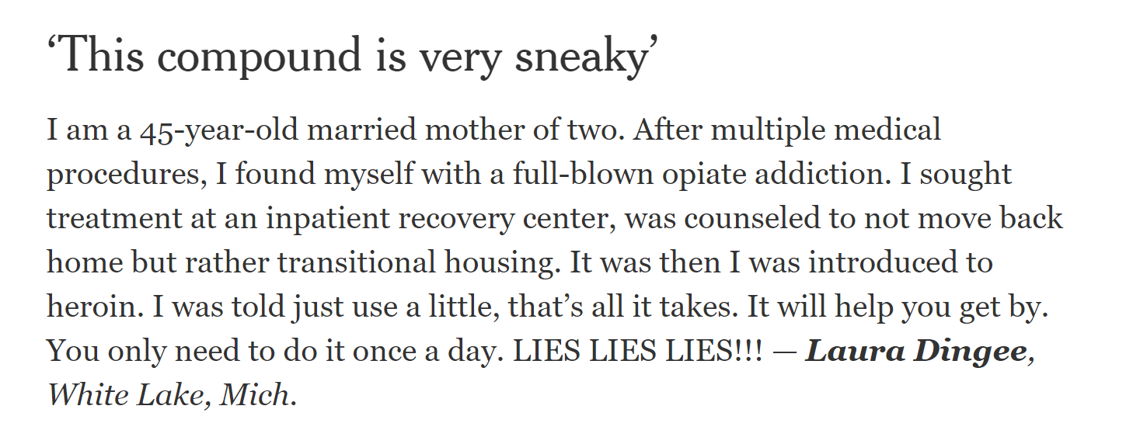
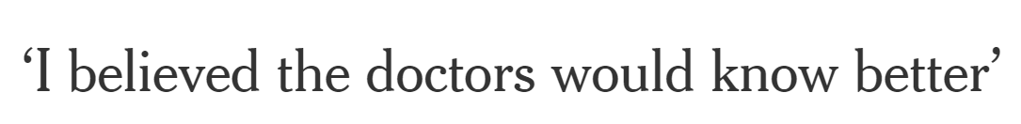
Opioid Analgesics
Addiction
New York Times, January 2017

Slide 7
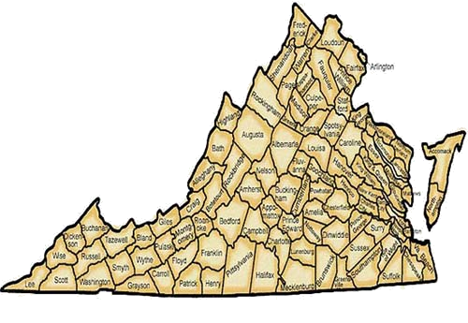
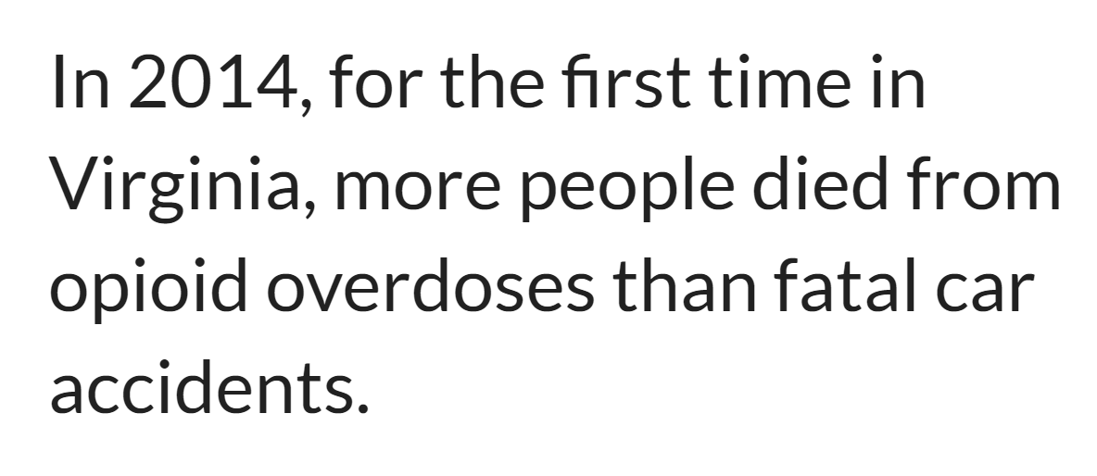

Opioid Analgesics
Addiction

Slide 8
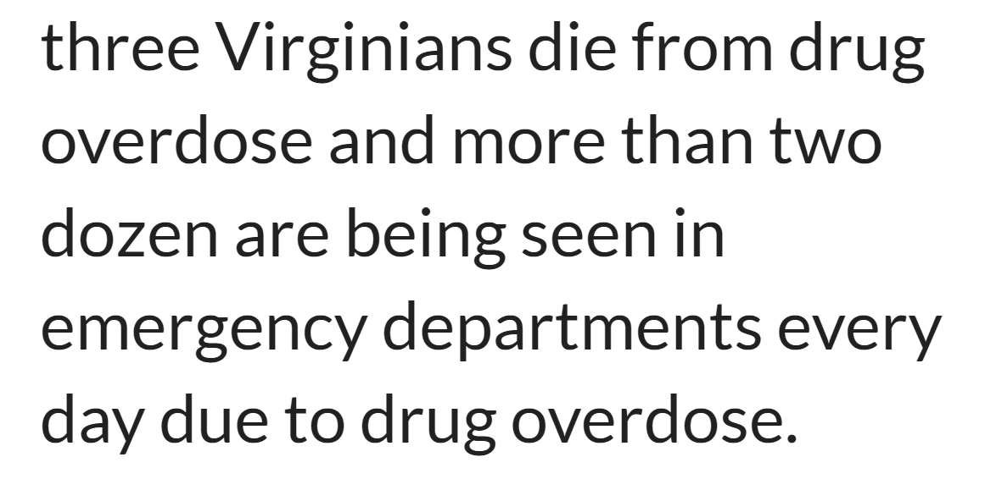
Opioid Analgesics
Addiction

Slide 9
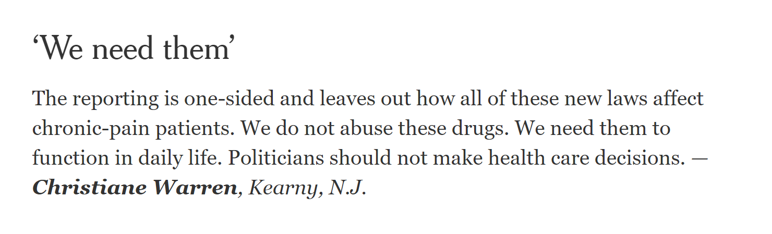
Opioid Analgesics
Addiction
New York Times, January 2017

Slide 10
Opioid Analgesics
Addiction

Slide 11
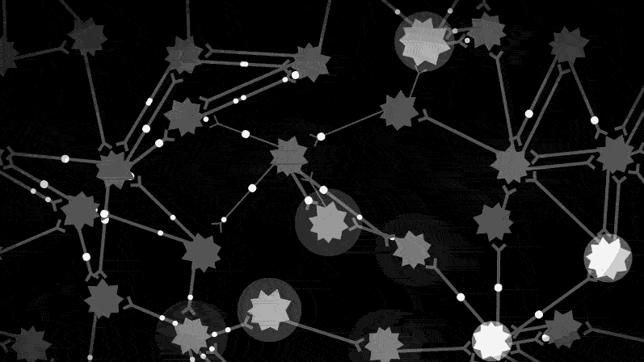
Neurons & Activity

Slide 12
Neurons & Activity
A. Neuronal Communication
synapse
receptor
for
transmitter
transmitter
-
opiods
B. Plug into Your Favorite Body Part
BRAIN
Intestines

Slide 13



“Opioid” Analgesics
1
Papaver somniferum
“opiate”: compounds structurally related to products found
in opium.
natural plant alkaloids
semi-synthetic derivatives
endogenous peptides (e.g. endorphins)
“opioid”: any substance, regardless of structure that has
functional/pharmacological properties of an opiate.
“narcotic”: derived from Greek word narkotikos for benumbing
or stupor. Word now associated with opiates and often used in
legal contexts.

Slide 14

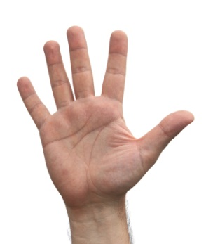



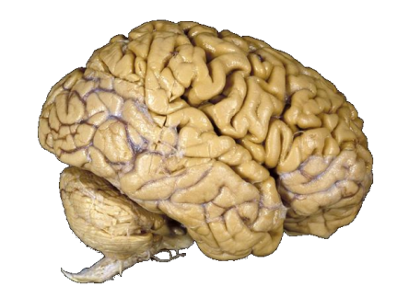
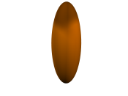





Pain
pain: perception of aversive/unpleasant sensation.
nociception: transmission of signals to CNS that provide info
about tissue damage.
ouch
spinal cord
OUCH!
DRG
nociceptor
ascending pathways
Aδ fibers
spinothalamic
C fibers
spinoreticular
spinomesencephalic
pains
acute nociception
tissue injury
factors released in injury site (e.g. prostaglandins, bradykinin,etc) activate
Aδ fibers
hyperalgesia (mildly warm water on a sunburn)
nerve injury
may involve low-threshold afferents (i.e. Aβ fibers)

Slide 15


Pain
pain: perception of aversive/unpleasant sensation.
nociception: transmission of signals to CNS that provide info
about tissue damage.
ouch
spinal cord
OUCH!
DRG
nociceptor
ascending pathways
Aδ fibers
spinothalamic
C fibers
spinoreticular
spinomesencephalic
pains
acute nociception
tissue injury
factors released in injury site (e.g. prostaglandins, bradykinin,etc) activate
Aδ fibers
hyperalgesia (mildly warm water on a sunburn)
nerve injury
may involve low-threshold afferents (i.e. Aβ fibers)

Slide 16


Opioids & Receptors
2
Endogenous Opioids
3 primary families:
endorphins
major peptide: β-endorphin
precursor: prepro-opiomelanocortin (POMC)
enkephalins
major peptides: met-enkephalin & leu-enkephalin
precursor: proenkephalin
dynorphins
major peptides: dynorphin A, dynorphin B & neoendorphin
precursor: prodynorphin
Receptors
3
3 receptor types (all GPCRs):
μ (MOR)
δ (DOR)
κ (KOR)
Widely distributed in the CNS
Not surprising considering profound effects opioids have on CNS
function

Slide 17
Receptor Distribution
Forebrain
Receptors
μ
κ
δ
4
Peckys & Landwehrmeyer, 1999

Slide 18
Receptor Distribution
Midbrain
Receptors
μ
κ
δ
4
Peckys & Landwehrmeyer, 1999

Slide 19
Receptor Distribution
Spinal Cord
Receptors
μ
κ
δ
Peckys & Landwehrmeyer, 1999
4

Slide 20
Opioids & Receptors
2
Endogenous Opioids
3 primary families:
endorphins
major peptide: β-endorphin
precursor: pro-opiomelanocortin (POMC)
enkephalins
major peptides: met-enkephalin & leu-enkephalin
precursor: proenkephalin
dynorphins
major peptides: dynorphin A, dynorphin B & neoendorphin
precursor: prodynorphin
Receptors
3
3 receptor types (all GPCRs):
μ (MOR)
δ (DOR)
κ (KOR)
Widely distributed in the CNS
Not surprising considering profound effects opioids have on CNS
function

Slide 21


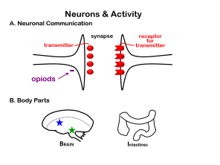

Opioids & Receptors
2
Endogenous Opioids
3 primary families:
endorphins
major peptide: β-endorphin
precursor: pro-opiomelanocortin (POMC)
enkephalins
major peptides: met-enkephalin & leu-enkephalin
precursor: proenkephalin
dynorphins
major peptides: dynorphin A, dynorphin B & neoendorphin
precursor: prodynorphin
Receptors
3
3 receptor types (all GPCRs):
μ (MOR)
Opens potassium channels
Closes calcium channels
Inhibits cAMP
Widely distributed in the CNS
Not surprising considering profound effects opioids have on CNS
function

Slide 22
Opioids & Receptors
Common Opioid Analgesics
Endogenous Opioids
Opioid
Receptor
μ
δ
κ
β-endorphin
+++
+++
met-enkephalin
++
+++
leu-enkephalin
++
+++
dynorphin A
++
+++
dynorphin B
+
+++

Slide 23
Opioids & Receptors
Common Opioid Analgesics
Opioid
Receptor
μ
δ
κ
Morphine
+++
+
Hydromorphone
+++
Oxymorphone
+++
Methadone
+++
Meperidine
+++
Fentanyl
+++
Sufentanil
+++
+
+
Alfentanil
+++
Remifentanil
+++
Levorphanol
+++
Codeine
+/-
Hydrocodone
+/-
Oxycodone
++
Pentazocine
+/-
+
Nalbuphine
--
++
Buprenorphine
+/-
--
--
Butorphanol
+/-
+++
5
Lange, 12th Edition

Slide 24
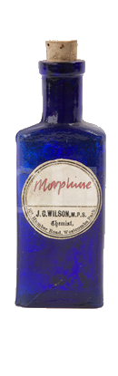
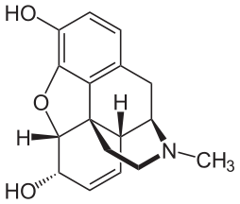
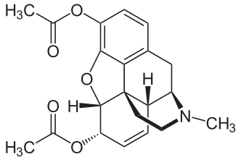
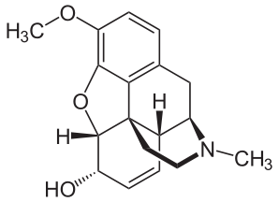
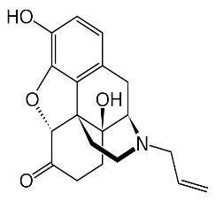
Morphine
6
morphine
heroin
codeine
naltrexone
Summary
Decreases pain but highly addictive
(addiction potential similar to that of heroin)
μ (MOR) – target of most opiate analgesics
MORs expressed in the periaqueductal gray (PAG)
MORs expressed in the spinal cord
“The analgesic actions of opiates after systemic delivery are
believed to represent actions in the brain, spinal cord, & in
some instances in the periphery.”
- Goodman & Gilman

Slide 25
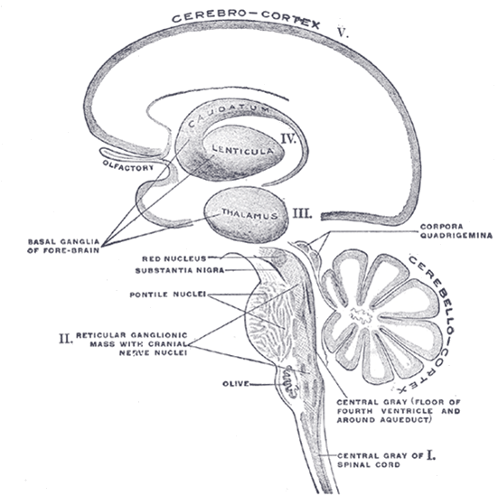
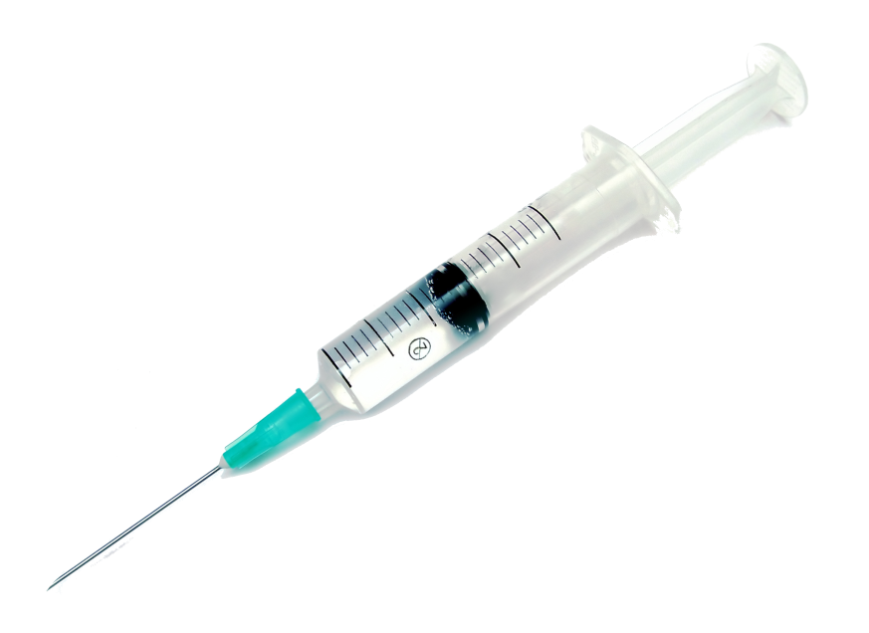
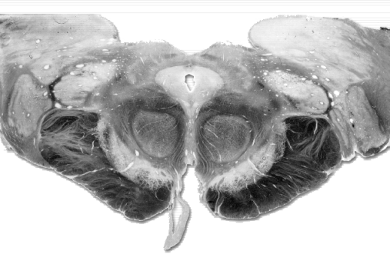
Periaqueductal Gray (PAG)
mesencephalic structure
projects to rostral
ventromedial medulla
7
constitutes essential
neural circuit for opioid-
based analgesia
high density of MORs
administration of
opioids directly into
PAG blocks nociceptive
responses in all animals
(rodents to primates)
naloxone blocks response
wikipedia
direct electrical stimulation
of PAG produces analgesia

Slide 26
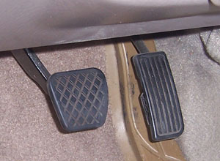



Mechanisms of Opiate Analgesia

Slide 27
Mechanisms of Opiate Analgesia
But What’s the Point?
Sometimes You’re Already to Go, but Something’s Stopping You

Slide 28

Mechanisms of Opiate Analgesia
But What’s the Point?
Sometimes You’re Already to Go, but Something’s Stopping You

Slide 29


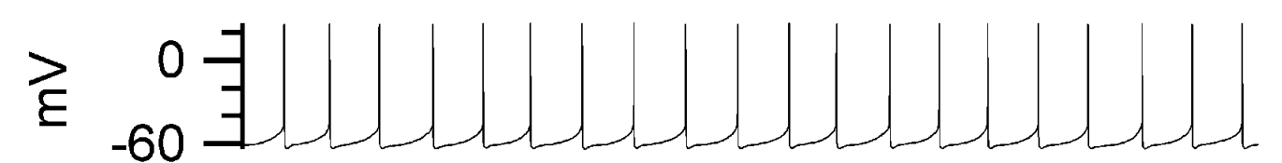
Mechanisms of Opiate Analgesia
Scenario #1
Activity
Action Potentials
“Tonically Active”
+
Activity When Inhibited?
Inhibitory
Neuron
“Inhibited”
Bruce Bean

Slide 30

Mechanisms of Opiate Analgesia
Scenario #2
Activity
Action Potentials
“Tonically Active”
X
Activity When Inhibited
Inhibitory
Neuron
“Dis-inhibited”

Slide 31
Mechanisms of Opiate Analgesia
Scenario #2
Activity
Action Potentials
“Tonically Active”
X
Activity When Inhibited
Inhibitory
Neuron
“Dis-inhibited”

Slide 32
Mechanisms of Opiate Analgesia
Scenario #2
But what’s the point?
“Tonically Active”
Neurons Do Not Require
Synaptic Excitation to Turn On
Removal of Inhibition (Dis-inhibition)
Can Also Turn Neurons On
Inhibitory
Neuron
“Dis-inhibited”

Slide 33
Periaqueductal Gray (PAG)
mesencephalic structure
projects to rostral
ventromedial medulla
7
constitutes essential
neural circuit for opioid-
based analgesia
high density of MORs
administration of
opioids directly into
PAG blocks nociceptive
responses in all animals
(rodents to primates)
naloxone blocks response
wikipedia
direct electrical stimulation
of PAG produces analgesia

Slide 34

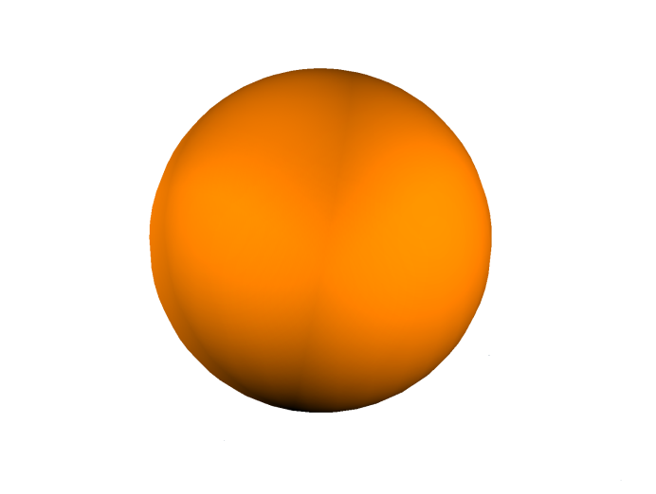


Mechanisms of Opiate Analgesia
PAG
Medulla
(nuclei raphe magnus)
excitation
spinal cord
serotonin
norepinephrine
dorsal horn excitability

Slide 35
Neuroscience Online: UT Health Center

Slide 36
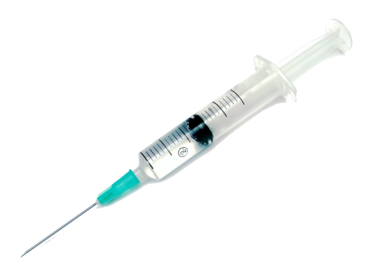
Mechanisms of Opiate Analgesia
PAG
Medulla
(nuclei raphe magnus)
excitation
spinal cord
serotonin
norepinephrine
dorsal horn excitability

Slide 37
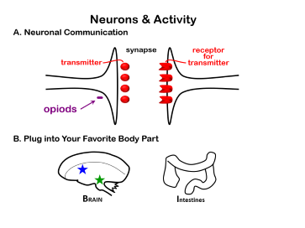

Mechanisms of Opiate Analgesia
PAG
Medulla
(nuclei raphe magnus)
excitation
spinal cord
serotonin
norepinephrine
dorsal horn excitability

Slide 38
Neurons & Activity
A. Neuronal Communication
synapse
receptor
for
transmitter
transmitter
-
opiods
B. Plug into Your Favorite Body Part
BRAIN
Intestines

Slide 39

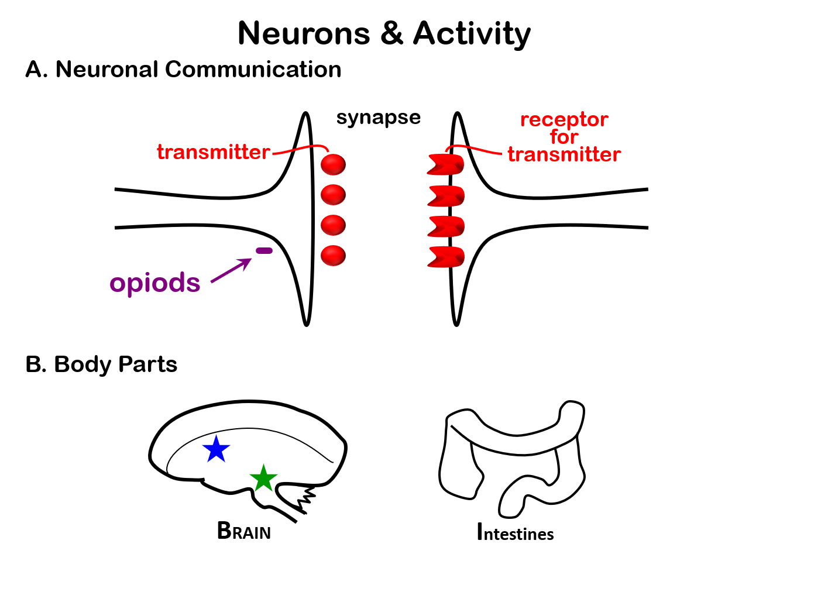
Mechanisms of Opiate Analgesia
PAG
excitatory projection neuron
inhibitory neuron
Medulla
(nuclei raphe magnus)
excitation
spinal cord
serotonin
norepinephrine
dorsal horn excitability

Slide 40
Mechanisms of Opiate Analgesia
PAG
excitatory projection neuron
inhibitory neuron
Medulla
(nuclei raphe magnus)
excitation
spinal cord
serotonin
norepinephrine
dorsal horn excitability

Slide 41

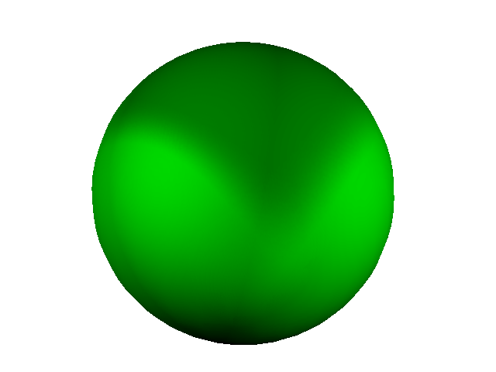

Mechanisms of Opiate Analgesia
PAG
excitatory projection neuron
inhibitory neuron
Medulla
(nuclei raphe magnus)
excitation
spinal cord
serotonin
axon
norepinephrine
terminal
GABA
Receptors
dorsal horn excitability

Slide 42
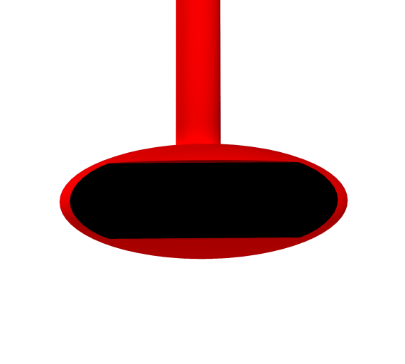
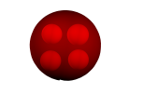
Mechanisms of Opiate Analgesia
PAG
excitatory projection neuron
inhibitory neuron
Medulla
(nuclei raphe magnus)
excitation
spinal cord
GABA
serotonin
Vesicle
norepinephrine
axon
terminal
GABA
Receptors
dorsal horn excitability

Slide 43
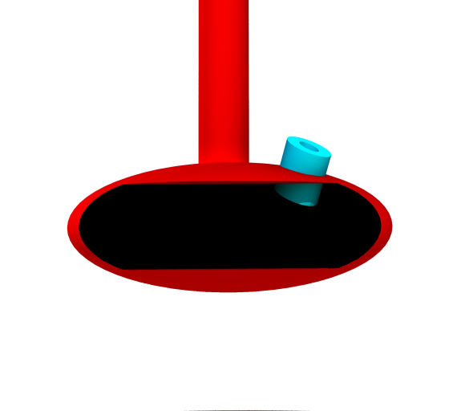

Mechanisms of Opiate Analgesia
PAG
excitatory projection neuron
inhibitory neuron
Medulla
(nuclei raphe magnus)
excitation
Calcium
Channel
spinal cord
GABA
serotonin
Vesicle
norepinephrine
axon
terminal
GABA
Receptors
dorsal horn excitability

Slide 44
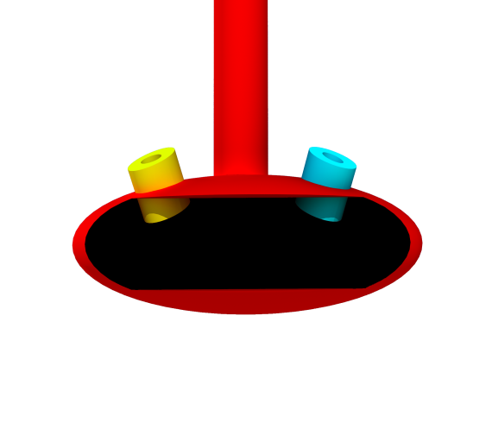

Mechanisms of Opiate Analgesia
PAG
excitatory projection neuron
inhibitory neuron
Medulla
(nuclei raphe magnus)
excitation
Potassium
Calcium
Channel
Channel
spinal cord
serotonin
axon
norepinephrine
terminal
GABA
Receptors
dorsal horn excitability

Slide 45
Mechanisms of Opiate Analgesia
one more time…
Potassium
Calcium
Channel
Channel
action
potential
1) Positive change in voltage opens calcium channels
GABA
2) Calcium influx triggers vesicle release
Vesicle
3) Opening potassium channels causes negative
change in voltage
axon
terminal
GABA
Receptors
4) Negative change in voltage: calcium channels less
likely to open.
8

Slide 46
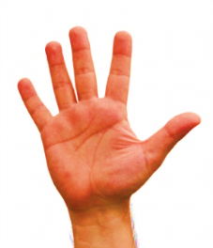




Mechanisms of Opiate Analgesia
PAG
excitatory projection neuron
1
inhibitory neuron
and peripheral actions…
Medulla
(nuclei raphe magnus)
9
excitation
Potassium
O
Calcium
and direct spinal actions…
Channel
Channel
DRG
spinal cord
MOR
+
-
serotonin
2
GABA
axon
Vesicle
norepinephrine
terminal
GABA
Receptors
dorsal horn excitability
disinhibition
8
C fiber

Slide 47
Opioids & Receptors
Common Opioid Analgesics
Opioid
Receptor
μ
δ
κ
Morphine
+++
+
Hydromorphone
+++
Oxymorphone
+++
Methadone
+++
Meperidine
+++
Strong Agonists
Fentanyl
+++
Sufentanil
+++
+
+
Alfentanil
+++
Remifentanil
+++
Levorphanol
+++
Codeine
+/-
Hydrocodone
Mild to Moderate Agonists
+/-
Oxycodone
++
Pentazocine
+/-
+
Nalbuphine
--
Mixed Actions
++
Buprenorphine
+/-
--
--
10
Butorphanol
+/-
+++
Lange, 12th Edition

Slide 48
Opioids & Receptors
Common Opioid Analgesics
Opioid
Morphine
Hydromorphone
Oxymorphone
Methadone
Meperidine
Fentanyl
Sufentanil
Alfentanil
Remifentanil
Levorphanol
Codeine
Hydrocodone
Oxycodone
Pentazocine
Nalbuphine
Buprenorphine
Butorphanol
Lange, 12th Edition

Slide 49
11
Physiological Effects of Morphine
CNS Effects
Analgesia
both sensory & emotional components
Euphoria
Sedation
more common in the elderly
more common with the phenanthrenes (codeine, hydrocodone)
Respiratory Depression
all opioid analgesics produce significant respiratory depression
by inhibiting brainstem respiratory mechanisms
dose-dependent
Cough Suppression
codeine
supresses cough reflex
Miosis
valuable for diagnosing overdose
Truncal Rigidity
Nausea & Vomiting
Temperature
opioids can produce either hyperthermia (MOR agonists) or
hypothermia (KOR agonists)

Slide 50
11
Physiological Effects of Morphine
CNS Effects
A
Analgesia
both sensory & emotional components
Euphoria
E
Sedation
S
more common in the elderly
more common with the phenanthrenes (codeine, hydrocodone)
R
Respiratory Depression
all opioid analgesics produce significant respiratory depression
by inhibiting brainstem respiratory mechanisms
dose-dependent
C
Cough Suppression
codeine
supresses cough reflex
Miosis
M
valuable for diagnosing overdose
T
Truncal Rigidity
Nausea & Vomiting
N
T
Temperature
opioids can produce either hyperthermia (MOR agonists) or
hypothermia (KOR agonists)

Slide 51
11
Physiological Effects of Morphine
M
R
A
T
S
C
E
N
T

Slide 52
11
Physiological Effects of Morphine
Peripheral Effects
Gastrointestinal
constipation
tolerance does not develop (i.e. effect does not diminish)
Biliary Tract
opioids contract biliary smooth muscle
can cause biliary colic
Renal
opioids depress renal function
Uterus
opioids may prolong labor

Slide 53
Clinical Uses of Morphine
12
Clinical Use
Analgesia
severe, constant pain usually relieved
sharp, intermittent pain less effectively controlled
Acute Pulmonary Edema
historically used to relieve dyspnea associated with pulmonary edema
HOWEVER, recent studies find little evidence in support of this use
Cough
Low dose oral morphine can significantly suppress chronic cough
but side effect profile may limit widespread utility
Codeine & dextramethorphan: commonly prescribed antitussives
Recent studies suggest that these have little/no efficacy relative
to placebo in humans with chronic cough
Diarrhea
Shivering

Slide 54

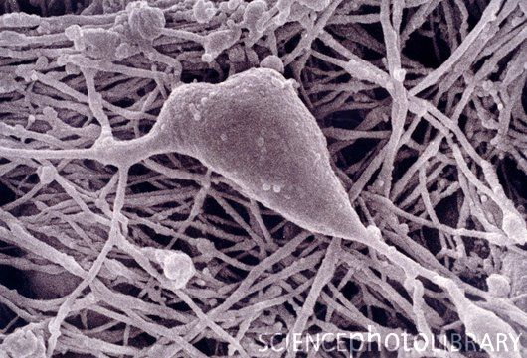
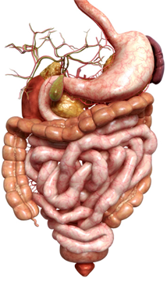
Side Effects of Morphine
13
Respiratory depression
Respiration rate is decreased
Affects respiratory centers (medulla oblongata & pons)
morphine reduces CO₂-dependent activation of respiratory centers
Dose threshold for analgesic & respiratory effects are the same
Lethal effects of morphine due to respiratory arrest, hypoxia &
cardiovascular collapse
14
15
Decreased gut motility (i.e. constipation)
Inhibits output of the myenteric plexus (also called “Auerbach’s” plexus)
Reduces propulsive contractions of longitudinal muscles
Myenteric Plexus
GI Tract
Acetylcholine

Slide 55
Side Effects of Morphine
13
Respiratory depression
Respiration rate is decreased
Affects respiratory centers (medulla oblongata & pons)
morphine reduces CO₂-dependent activation of respiratory centers
Dose threshold for analgesic & respiratory effects are the same
Lethal effects of morphine due to respiratory arrest, hypoxia &
cardiovascular collapse
14
15
Decreased gut motility (i.e. constipation)
Inhibits output of the myenteric plexus (also called “Auerbach’s” plexus)
Reduces propulsive contractions of longitudinal muscles
16
Difficulty with urination
Inhibits urinary voiding reflex
Catheterization may be required after therapeutic doses of morphine
17
May cause orthostatic hypotension
Morphine is a powerful depressant of the medullary vasomotor center
Has relatively little effect on blood pressure when recumbant
Can produce severe hypotension in patient who has lost blood
Allergic reaction

Slide 56




Differences Among the Major Opiates
Potency
(Very Potent)
18
(Less Potent)
Dephenoxylate &
Lopermide
Codeine
Meperidine
Morphine
& Oxycodone
(OxyContin)
Methadone
Heroin
Fentanyl
Sufentanyl
very lipophilic
Duration of Action
(Long Lasting)
20
(Medium Lasting)
19
(Short Lasting)
Fentanyl (oral)
Meperidine
Morphine
Methadone (oral)
Fentanyl (patch)
IV drip
21
Partial MOR agonists: Pentazocine & Buprenorphine
Used to treat pain
Less respiratory depression
Can antagonize respiratory depression produced by Fentanyl without
completely reversing pain (Buprenorphine)
But can cause hallucinations/nightmares (Pentazocine)

Slide 57

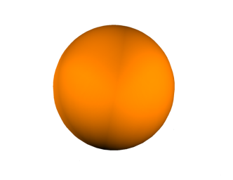



Opiate Abuse
Opiates have powerful effect on reward pathway
Mechanism: increase dopamine release from the ventral
tegmental area (VTA)
VTA
Nucleus Accumbens
cell body
inhibitory
axon
MOR
synapse
GABA
GABA
dopamin-
receptor
ergic
Treatment
Medically supervised withdrawal alone is often insufficient to prevent relapse
22
Withdrawal symptoms:
Dysphoria, anxiety, restlessness, insomnia
High blood pressure, tachycardia, diarrhea

Slide 58
Opiate Overdose
Symptoms
Very low respiratory rate
Hypotension
Hypothermia
Pin-point pupils (except when hypoxia becomes severe)
Coma
Treatment
Ventilation
23
Naloxone (repeated, small IV doses)
Opiate receptor antagonist (MOR)
…or an inverse agonist?
Reverses all effects except whose due to prolonged hypoxia
Has very little oral bio-availability
Short T1/2
Naltrexone Comparison. Naltrexone:
Longer T1/2
Can be taken orally
Primarily used for long-term treatment of opioid addiction
Nalmefene Comparison. Nalmefene:
Longer T1/2
Can be taken orally
Expensive
More universal antagonist: MOR, KOR, DOR
Primarily used for management of alcohol dependence

Slide 59
Opioid Analgesics
Addiction
New York Times, January 2017

Slide 60
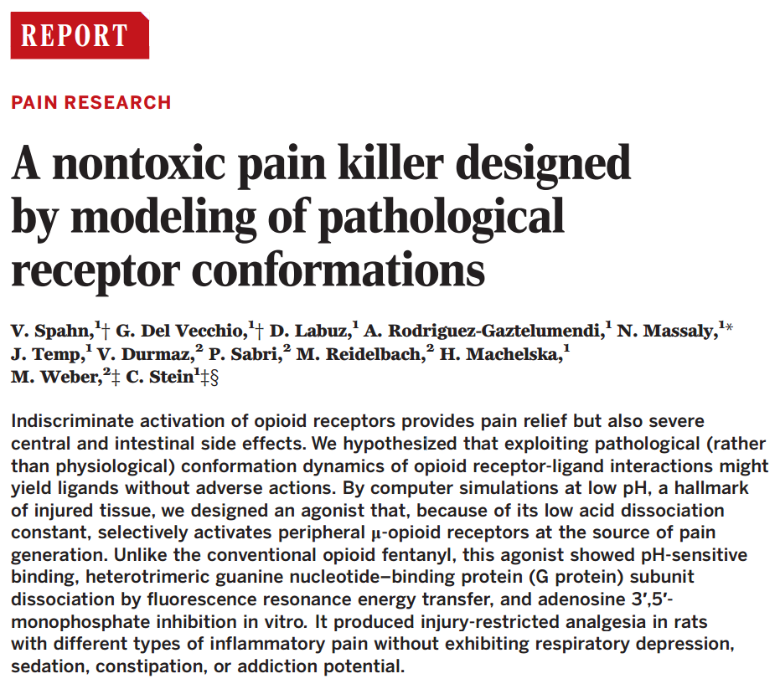
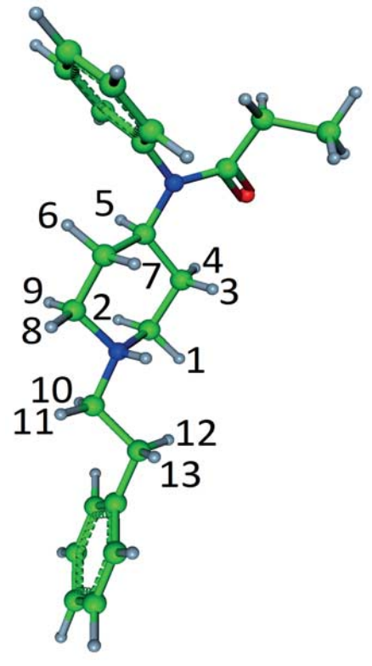
Opioid Analgesics
Addiction

Slide 61







Quiz
24
opiate-free
taking opiates for pain
dependent on opiates
never abused opiates
currently under the
influence of opiates
Naloxone

Slide 62


Quiz
25
opiate-free
taking opiates for pain
dependent on opiates
never abused opiates
currently drug free
Naloxone
Buprenorphine

Slide 63
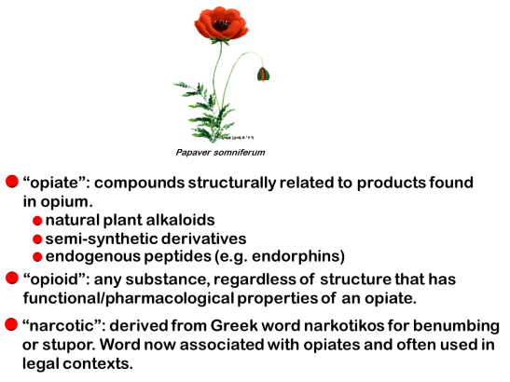
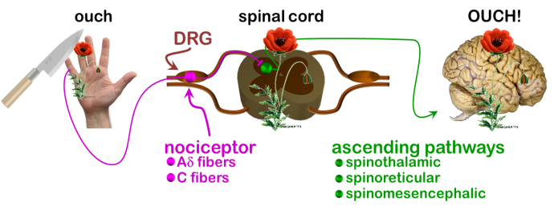
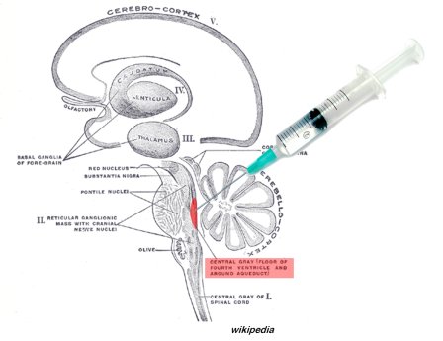
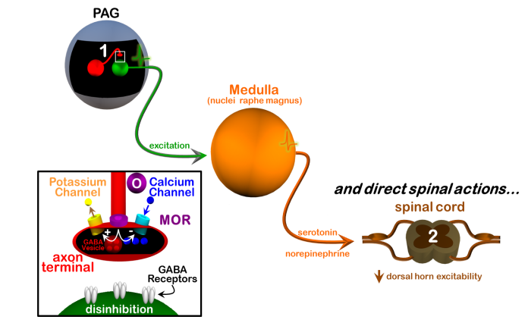
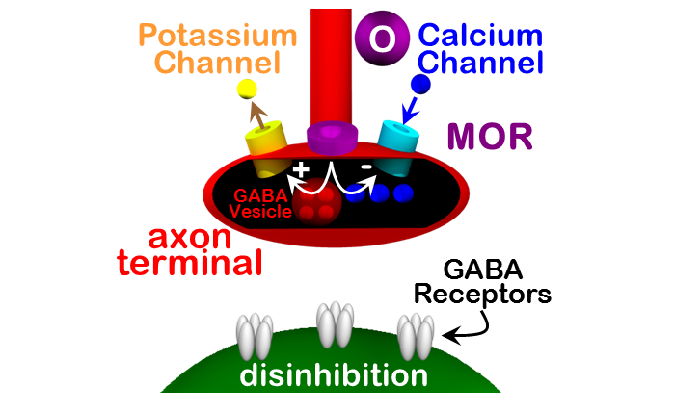
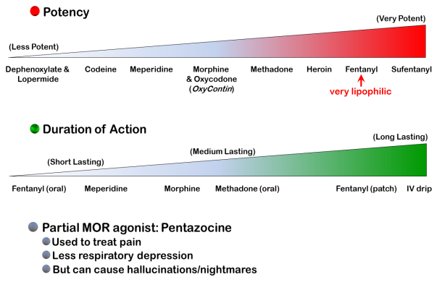
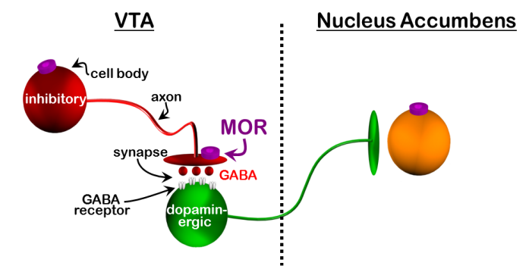
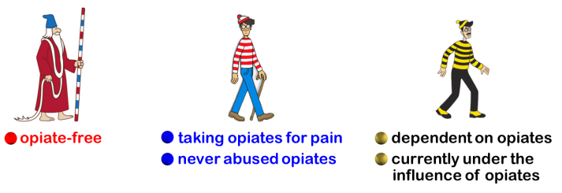
Summary
Opiates
Pain & Nociception
μ Receptors &
Periaqueductal Gray
2 Sites of Analgesia
Presynaptic Regulation of Release
Potency & Duration Differences
Abuse & Reward Pathways
Prior Opiate History Important

Slide 64

suggested reading
Basic & Clinical Pharmacology, 12th ed. (chapter 31)
Bertram G. Katzung, Susan B. Masters, Anthony J. Trevor
Pharmacological Basis of Therapeutics, 12th ed. (Chapter 18)
Goodman & Gilman
questions:
markbeen@virginia.edu

